Slide 1


Status Update #5
Sponsor: Max Lesser
TA: Dalton W. Cyr
Team 6: GrAPE (Graphic Analog Portable Equalizer)
Antonio Cardona
Nathan Finley
Nicole LoGiudice
Notes:
template slide

Slide 2

Project Summary
Graphic Analog Portable Equalizer
Problem Statement
The current market lacks equalizers that can be used in settings where complete wirelessness is needed.
Without both bluetooth input and output connectivity, a user is unable to control his/her speaker system settings on-the-go, and must instead have a dedicated location next to a speaker system from which to control a sound system.
Solution Proposal
The GrAPE is a graphic analog portable equalizer for the frequency range of 0-20 kHz with the ability to connect via Bluetooth or Auxiliary to any device/speaker with
these applications.
Notes:
Talk about what an equalizer is
Problem Statement about equalizers

Slide 3
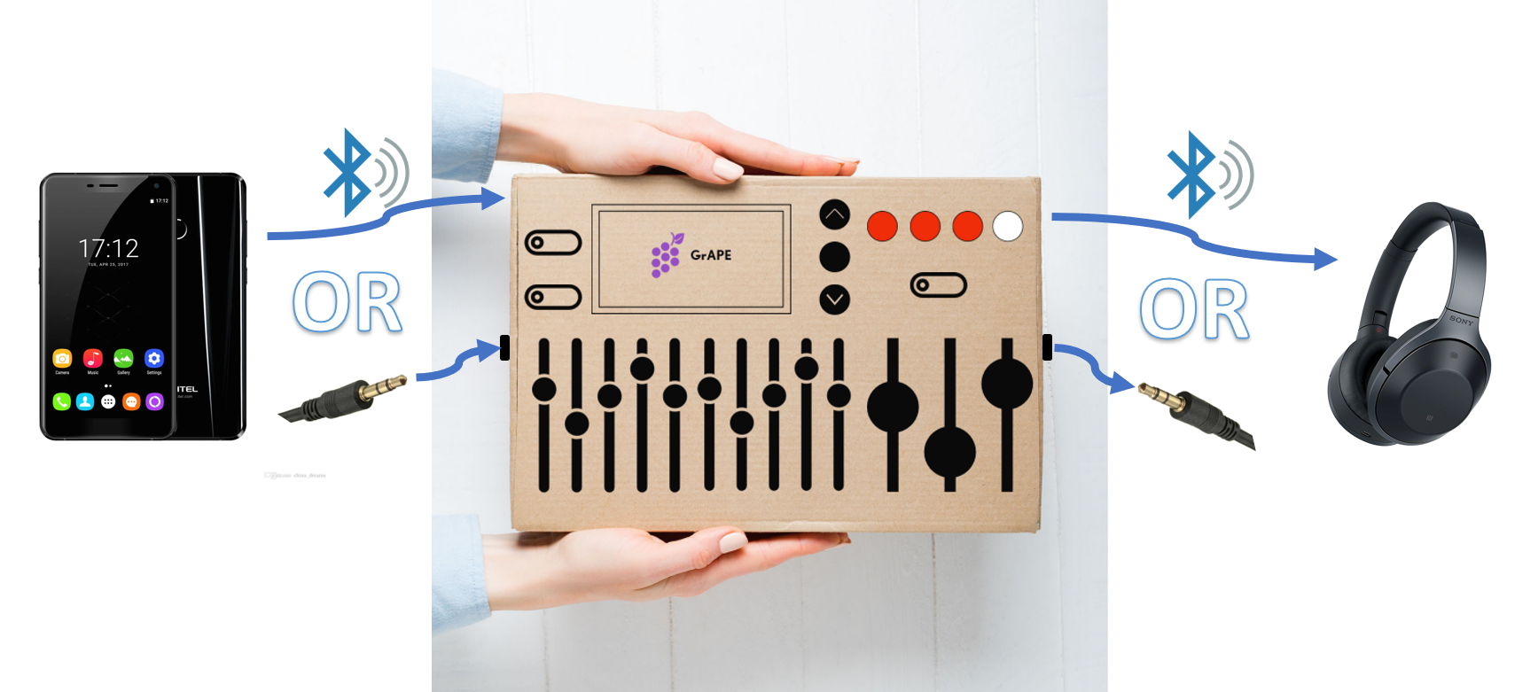
Integrated System Design
Graphic Analog Portable Equalizer

Slide 4
Project Timeline
Graphic Analog Portable Equalizer
Jan - Early Feb
Jan - Mid Feb
Mid Feb - Mar
Mar
Apr
Pre-Integration
PCB Design
Integration
Troubleshooting/Testing
Validation
Complete items required for integration
Design and order PCBs
Connect individual Subsystems
Solve any problems that appear once connecting to other Subsystems
Document end product specifications.
Behind
Working On,
On Schedule
Completed
Not Started,
Future
Notes:
Nathan and Antonio are still soldering/troubleshooting each of their PCBs. LCD code is fully integrated and performing the basic functions. Nicole and Antonio have started validation on Bluetooth and Power.

Slide 5
Antonio Cardona
Graphic Analog Portable Equalizer
Accomplishments since last update: 62 hrs of effort | Ongoing progress/problems and plans until the next presentation
Validated the following DC-DC Converters: +5.0V, +3.3V, -15.0V Completed integration between LCD and Bluetooth transmitter | Problems: +15.0V DC-DC Converter not handling load In 2 weeks… Test and validate remaining converter (+15.0V) Build and test charging circuit and battery fuel gauge
Notes:
ESP32 LCD Code:
Hello World!
Address Mapping for new SunFounder LCD
Function Setting
Digital Read on ESP32
UP, DOWN buttons with movable cursor
Iteration through char name
SELECT button implementation ~ infinite loop fixed
*Scroll Down Menu + displaying more than 4 receivers
Order Parts
done

Slide 6
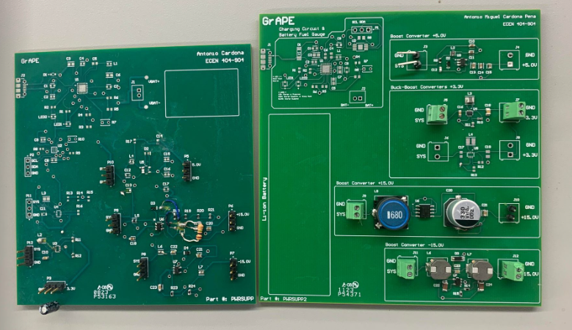
Old and New Board
Graphic Analog Portable Equalizer
Antonio Cardona
Notes:
ESP32 LCD Code:
Hello World!
Address Mapping for new SunFounder LCD
Function Setting
Digital Read on ESP32
UP, DOWN buttons with movable cursor
Iteration through char name
SELECT button implementation ~ infinite loop fixed
*Scroll Down Menu + displaying more than 4 receivers
Order Parts
done

Slide 7
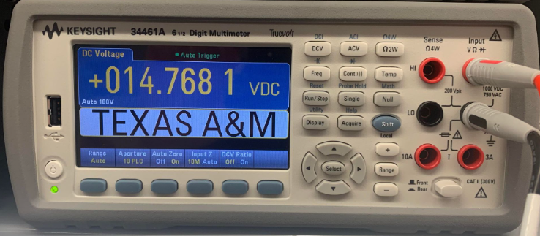
Graphic Analog Portable Equalizer
Boost Converter +15.0V
Antonio Cardona
Notes:
3.32V at 500mA load

Slide 8
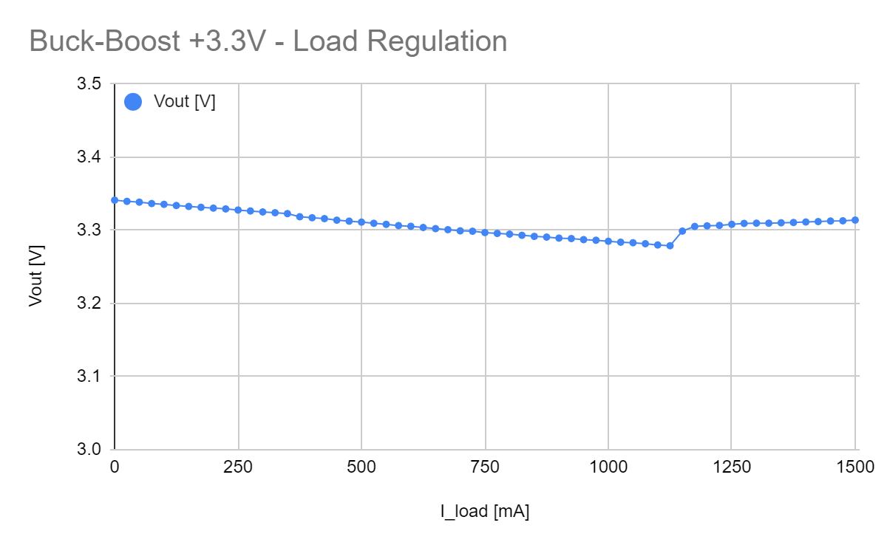
Graphic Analog Portable Equalizer
Buck-Boost Converter +3.30V
Antonio Cardona
Expected Current Load of 1A for 2x ESP32s
Notes:
3.32V at 500mA load

Slide 9
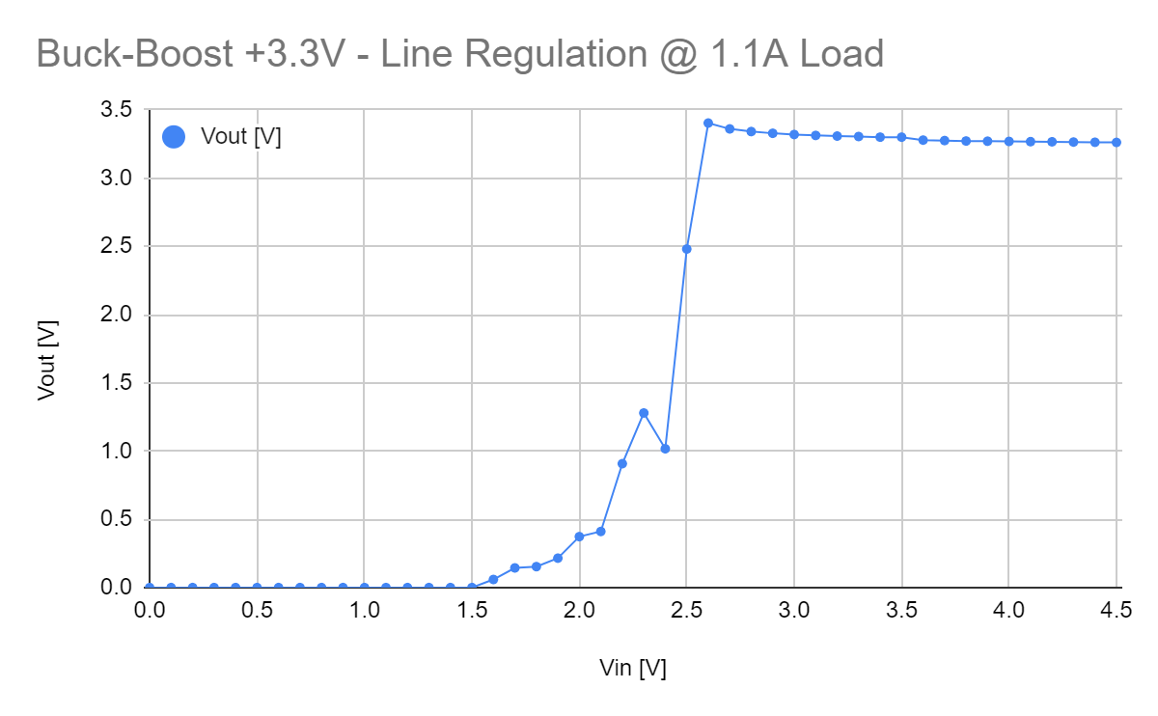
Graphic Analog Portable Equalizer
Buck-Boost Converter +3.30V
Antonio Cardona
Expected Current Load of 1A for 2x ESP32s
Notes:
3.32V at 500mA load

Slide 10
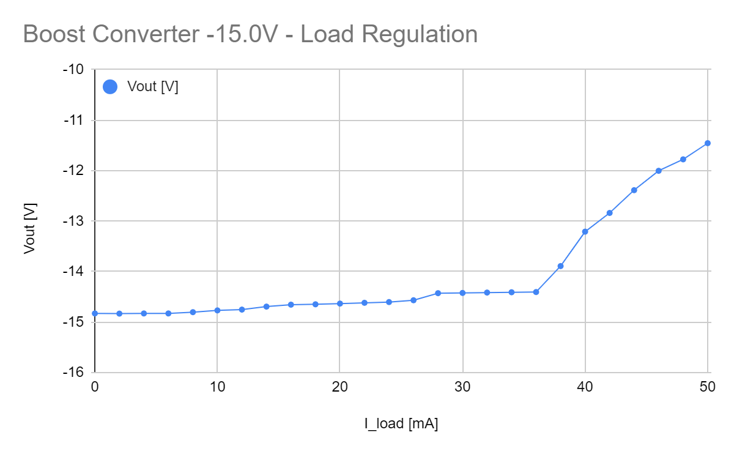
Graphic Analog Portable Equalizer
Buck-Boost Converter -15.0V
Antonio Cardona
Expected Current Load of 100mA for Nathan’s Subsytem
Notes:
3.32V at 500mA load

Slide 11
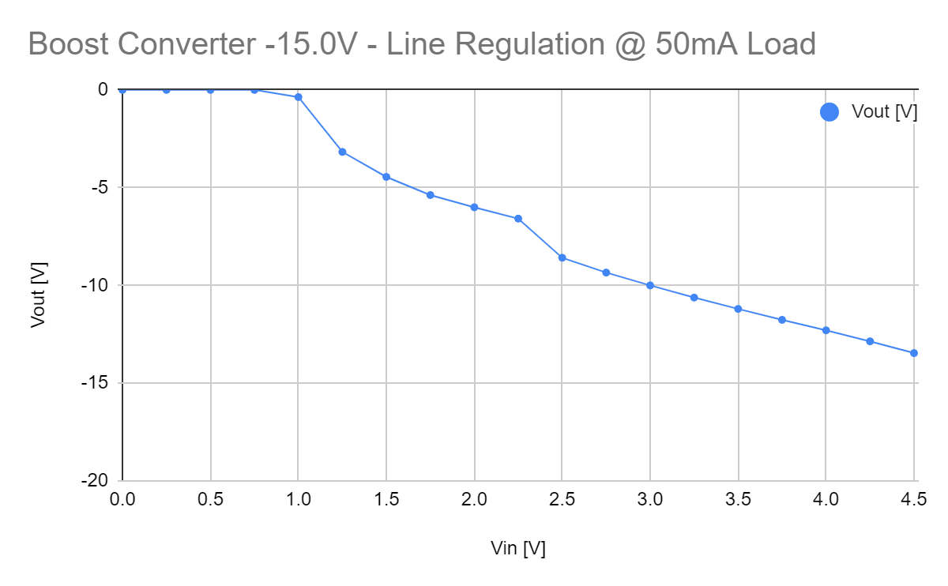
Graphic Analog Portable Equalizer
Buck-Boost Converter -15.0V
Antonio Cardona
Expected Current Load of 100mA for Nathan’s Subsytem
Notes:
3.32V at 500mA load

Slide 12
Nathan Finley
Graphic Analog Portable Equalizer
Accomplishments since last update: 20 hours of effort | Ongoing progress/problems and plans until the next presentation
Received PCB Constructed input buffer: operational Constructed L+R master gain: operational Constructed 30Hz sliding band: works on wrong frequency | 2 Week Goal Finish remaining bands Finish output-summing amplifier Test with bluetooth output tool + integrate with Nicole

Slide 13
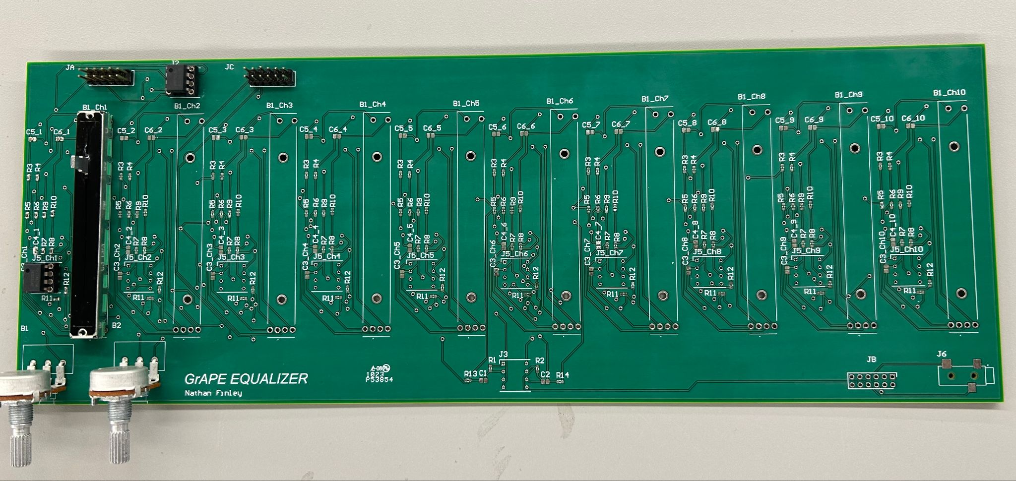
Equalizer

Slide 14
Nicole LoGiudice
Graphic Analog Portable Equalizer
Accomplishments since last update: 29 Hours | Ongoing progress/problems and plans until the next presentation
LCD code fully integrated & tested, now connects to specified speaker | Soldering/Testing/Validating Updated PCB
Bluetooth Receiver and Transmitter PCBs both receiver or transmit audio and plays said audio | Continue validation for old PCBs as back up
Notes:
Transmitter and Receiver PCBs both work (play audio to connected speaker) with their own quirks. Receiver: connects to phone via Bluetooth, the DAC on the PCB does not work, connected to DAC used from Demo last semester it does play audio/songs. This is considered as back up plan. Transmitter: connects to speaker via Bluetooth, transmits the sine wave, sound gets louder when input amplitude is changed just has some noise in the sound.
Updated PCB: implements a new DAC for the Receiver, has the input analog signal closer to the ESP32 to reduce noise and is not close to other routes.

Slide 15
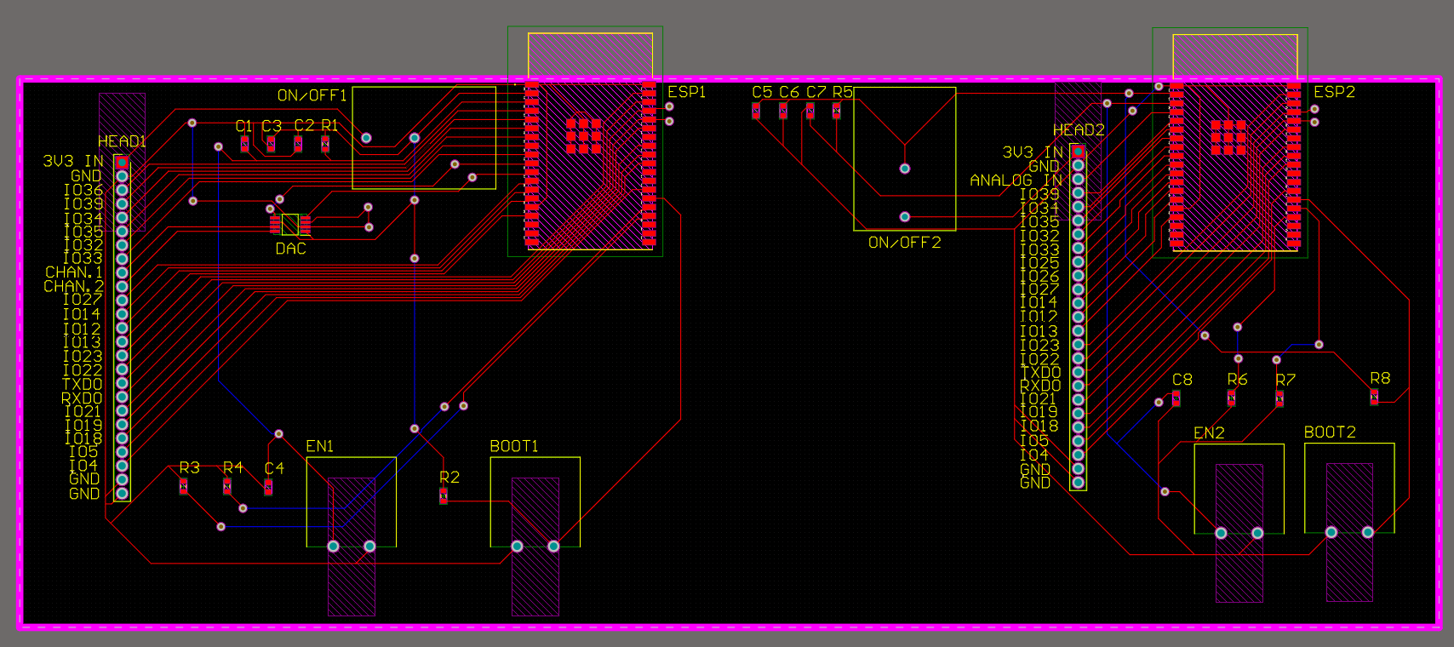
Bluetooth Receiver & Transmitter
Graphic Analog Portable Equalizer
Nicole LoGiudice
Notes:
New DAC, shorter Analog in route

Slide 16
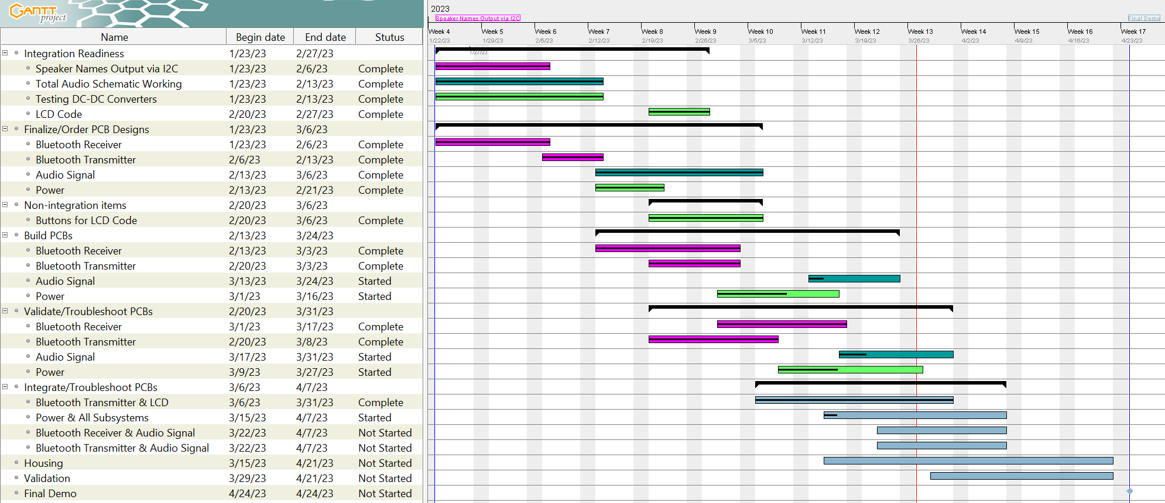




Execution Plan
Graphic Analog Portable Equalizer
Antonio
Nathan
Nicole
General Team

Slide 17
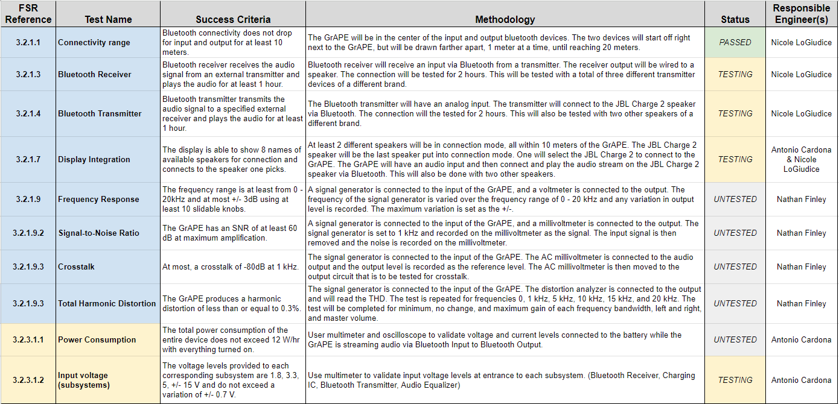
Validation Plan
Graphic Analog Portable Equalizer
Notes:
Antonio has started validating his voltages with the E-Load. Has completed 3.3V. Nicole started validation on sections using the old PCBs just in case we need to use them.

Slide 18

Thank you - Any Questions?
GrAPE

